Slide 1
3-X History, Files, Paths

Slide 2
CSC-60 Unix History

Slide 3
A brief history of UNIX OS
The Unix OS was developed (based on Multics & CTSS operating systems) by Ken Thompson at the AT&T Bell Laboratories in 1969. He wanted to create a multi-user operating system to run “Space Wars” game.
Ken’s philosophy was to create an operating system with commands or “utilities” that would do one thing well (i.e. UNIX). Pipes could be used combine commands...

Slide 4
History of Unix OS
The first versions of UNIX were written in “machine-dependent” program (such as PDP-7).
Ken Thompson approached Dennis Ritchie, developer of C language, and in 1973 they compiled UNIX in C to make operating system “portable” to other computer’s systems.

Slide 5
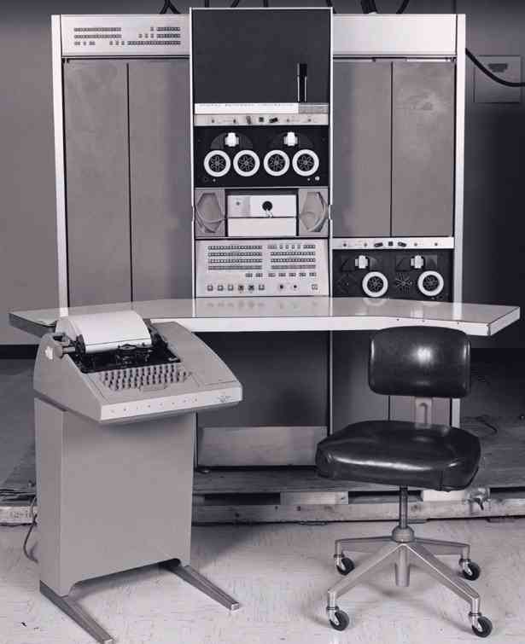
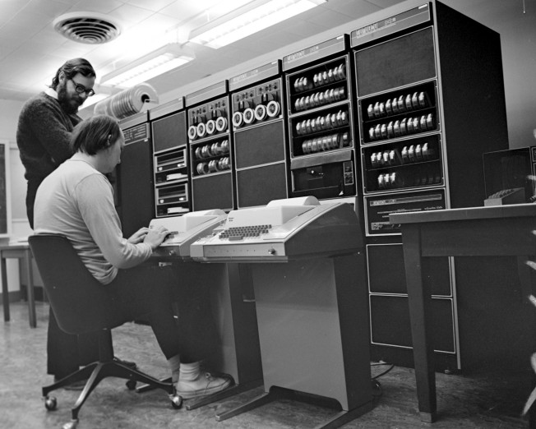
History of Unix OS
PDP-7 Machine
Ken (seated) and Dennis (standing) at a PDP-11
in 1972.

Slide 6
Development of Unix OS
Students at University of California (in Berkeley) further developed the UNIX operating system and introduced the BSD version of Unix
Unix
Bell Labs UNIX System V (5) Proprietary (Commercial Implementations)
Berkeley Software Distribution (BSD - 1979) Free
1981: Berkeley UNIX 4.1 BSD (enhanced with vi, csh, and virtual memory management)
1983: Berkeley UNIX 4.2 BSD (added TCP/IP networking, sockets and a new file system)
Notes:
Spent at UCB 1 year of sabbatical leave as visiting prof.

Slide 7
Development of Unix OS
There were versions of UNIX for the Personal Computer (PC), such as XENIX, etc., but they didn’t catch on in popularity until Linux was developed in the early 90’s.
Notes:
Xenix is a discontinued version of the Unix operating system for various microcomputer platforms, licensed by Microsoft from AT&T Corporation in the late 1970s.

Slide 8
History of Linux
Linux operating system developed by programming student Linus Torvalds (1991)
Linus wanted to develop Unix-like OS just to experiment with new 386 computer at the time...
Linus invited other programmers to improve the Kernel. Overtime, it was ported to various hardware architectures

Slide 9
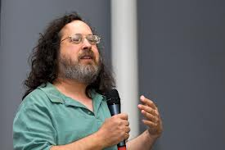
GNU (GNU ‘s NOT UNIX) Project
Launched in 1984 to develop a complete UNIX Operating system that is free software: www.gnu.org (Free Software Foundation - founded by Richard Stallman)
Usually C code, but some C++
GNU has a 72-page document of coding standards – well-written code. It provides useful tools such as Emacs, Gcc, Bash shell, glibc (C library)
GNU’s kernel (Called Hurd) was not working (not stable).
Richard Stallman

Slide 10
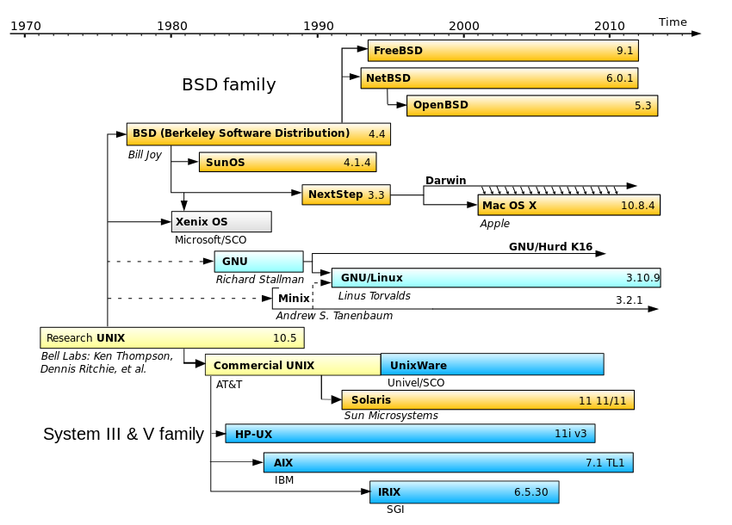
Brief history of Unix-like operating systems
Source: http://en.wikipedia.org/wiki/Linux

Slide 11
Standardizations (1 of 2)
POSIX: Portable Operating System Interface
An IEEE-standard which describe the behavior of UNIX and UNIX-like OS.
POSIX support assures code portability between systems and is increasingly mandated for commercial applications and government contracts.

Slide 12
Standardizations (2 of 2)
SUSv3: Single UNIX Specification version 3
Beginning in 1998,joint working group known as the Austin Group began to develop the combined standard that would be know as the Single UNIX Specification Version 3 and as POSIX:2001. This name serves as referenced points throughout the book.
Examples from our main textbook:
…This 65-character set, {-._a-zA-Z0-9], is referred to in SUSv3 as the portable filename character set. Page 28.
…And Standard system defined by SUSv3… Page 43.

Slide 13
Operating Systems

Slide 14
Operating System
An operating system is a control program for a computer that performs the following operations:
allocates computer resources
schedules tasks
provides a platform to run application software for users to accomplish tasks
provides an interface between the user & the computer

Slide 15
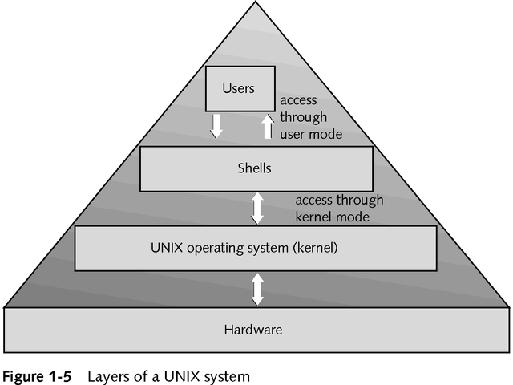
Notes:
When the CPU is in kernel mode, it is assumed to be executing trusted software, and thus it can execute any instructions and reference any memory addresses (i.e., locations in memory). The kernel (which is the core of the operating system and has complete control over everything that occurs in the system) is trusted software, but all other programs are considered untrusted software. Thus, all user mode software must request use of the kernel by means of a system call in order to perform privileged instructions, such as process creation or input/output operations.
Reference: http://www.linfo.org/kernel_mode.html

Slide 16
Shell as a user interface
A shell is a command interpreter, an interface between a human (or another program) and the OS
runs a program, perhaps the ls program.
allows you to edit a command line.
can establish alternative sources of input and destinations for output for programs.
ls, itself, just another program
ps also is just another program

Slide 17
Kernel (OS)
Interacts directly with the hardware through device drivers
Provides sets of services to programs, insulating these programs from the underlying hardware
Manages memory, controls access, maintains file system, handles interrupts, allocates resources of the computer
Programs interact with the kernel through system calls

Slide 18
UNIX Software Architecture
Application
User’s Interface
(AUI)
Applications: Compilers, word processors, spreadsheets, ftp, telnet, Web browser, etc.
UNIX shell:
Language libraries: C, C++, Java, FORTRAN, etc.
System call interface (entry points to kernel)
UNIX kernel:
Device Drivers: Mouse driver, printer driver, CD-ROM driver, hard disk driver, etc.
Hardware: Wires, capacitors, resistors, transistors, ICs, mouse, display monitor, keyboard, CPU, RAM, hard disk, CD_ROM, printer, etc.
Application
Programmer’s Interface (API)
Interprocess
Communication (IPC)
File management
Operating
System
Primary and secondary
storage management
Process Management
CPU scheduler
Source:
UNIX the textbook.
By Sarwar, Koretsky, Sarwar.

Slide 19
Linux File Attributes

Slide 20
File attributes
Every file has some attributes:
Access Times:
when the file was created
when the file was last changed
when the file was last read
Size
Owners (user and group)
Permissions
Type – directory, link, regular file, etc.
Notes:
mtime — updated when the file contents change. This is the "default" file time in most cases.
ctime — updated when the file or its metadata (owner, permissions) change
atime — updated when the file is read
Few examples:
ls –l –time=atime (atime when file was read)

Slide 21
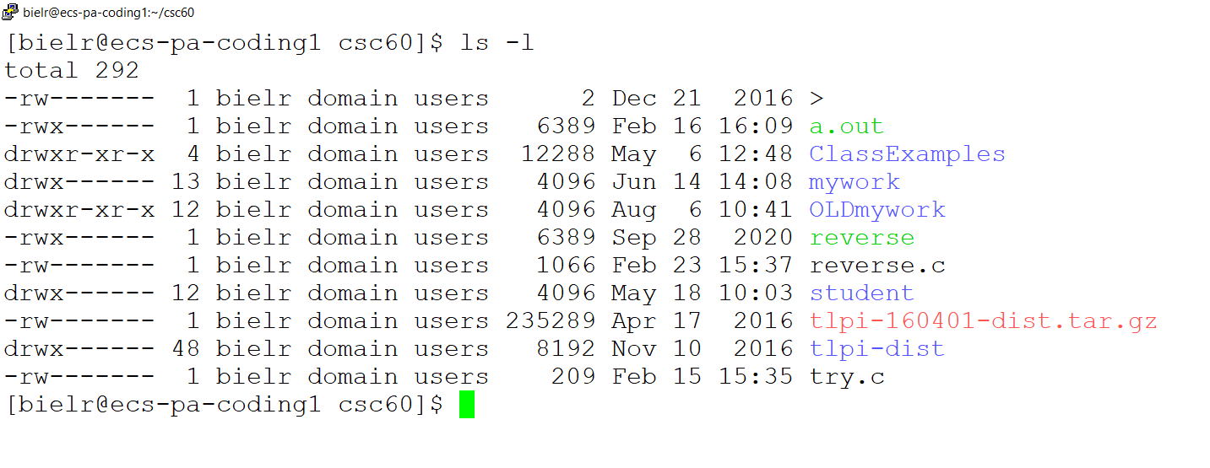
File Owners
Each file is owned by a user.
You can find out the username of the file's owner with the -l or -o option to ls:

Slide 22
File Attributes shown by ls –l
drwxr-xr-x 2 bielr domain users 4096 Apr 27 15:43 ClassExamples/
Field | Meaning
First letter of first field | File type: - ordinary file b block special file c character special file d directory l link p named pipe (FIFO) s socket

Slide 23
File Attributes shown by ls –l
drwxr-xr-x 2 bielr domain users 4096 Apr 27 15:43 ClassExamples/
Field | Meaning
Remaining letters of first field | Access permissions for owner, group, and others (r w x)
Second field | Number of links

Slide 24
File Attributes shown by ls –l
drwx------ 2 bielr domain users 4096 Apr 27 15:43 ClassExamples/
Field | Meaning
Third field | Owner’s login name
Fourth field | Owner’s group name (can also be a number)

Slide 25
File Attributes shown by ls –l
drwx------ 2 bielr domain users 4096 Apr 27 15:43 ClassExamples/
Field | Meaning
Fifth field | File size in bytes
Sixth, seventh, and eighth field | Date and time of last modification
Ninth field | File name

Slide 26
File Permissions

Slide 27
File Permissions
Each file has a set of permissions that control who can work with the file.
There are three types of permissions:
read abbreviated r
write abbreviated w
execute abbreviated x
There are 3 sets of permission:
User/owner
group
other (the world, everybody else)

Slide 28
ls -l and permissions
-rwxrwxrwx
User Group Others
Type of file:
- – plain file
d – directory
s – symbolic link

Slide 29
rwx
Since files and directories are related but not the same, their approach to permissions is a bit different.
Files:
r - allowed to read.
w - allowed to write
x - allowed to execute
Directories:
r - allowed to see the names of the files.
w - allowed to add and remove files.
x - allowed to enter the directory

Slide 30
Changing Permissions
The chmod command changes the permissions associated with a file or directory.
There are a number of forms of chmod. This is the simplest:
chmod mode file
Examples follow on the next slides.

Slide 31
chmod – numeric modes
Consider permission for each set of users (user, group, other) as a 3-bit #
r – 4
w – 2
x – 1
A permission (mode) for all 3 classes is a 3-digit octal #
755 – rwx r-x r-x (user: read/write/execute, group:read/execute, others:read/execute)
Example: > chmod 755 lab1.c
644 – rw- r— r– (user: read/write, group:read, others:read)
700 – rwx --- --- (user: read/write/execute, group: no access, others: no access)

Slide 32
chmod – symbolic modes
Can be used to set, add, or remove permissions
Mode has the following form:
[ugoa][+-=][rwx]
u – user g – group o – other a – all
+ add permission
- remove permission
= set permission

Slide 33
chmod examples, symbolic mode
$ ls -al foo
-rwx rwx --x 1 hollingd grads foo
$ chmod g-wx foo
$ ls -al foo
-rwx r-- --x 1 hollingd grads foo
$ chmod u-r .
$ ls
ls: .: Permission denied
Notes:
Note: the dash in front of -rwx rwx --x (this dash means the file is a plain file, not directory or link file)

Slide 34
Unix/Linux File System

Slide 35
Home Directory
The user’s personal directory. E.g.,
Student
/home/student/SaclinkUsername
/home/student/smithjohn
Faculty
/home/college/bielr
Where all your files go (hopefully organized into subdirectories)

Slide 36
Home Directory
Your current directory is where you land when you log in.
cd (by itself) takes you home from anywhere on the system.

Slide 37
Directories
A directory is a special kind of file - Unix uses a directory to hold information about other files and directories.
We think of a directory as a container that holds other files (or directories).
A directory is the same idea as a folder on Windows.

Slide 38
More about File Names
Review: every file has a name (at least one).
Each file in the same directory must have a unique name.
Files that are in different directories can have the same name.

Slide 39
File Time Attributes
Time Attributes:
when the file was last changed ls -l
sort by modification time ls -lt

Slide 40
Unix Filesystem
The filesystem is a hierarchical system of organizing files and directories.
The top level in the hierarchy is called the "root" and holds all files and directories in the filesystem.
The name of the root directory is “ / “

Slide 41
Pathname Examples
/
bin/
etc/
home/
tmp/
usr/
bielr/
scully/
bin/
local/
netprog
unix/
X
ls
who
Syllabus
/usr/bin/ls
/home/bielr/unix/Syllabus
/home/bielr/unix/Syllabus is the pathname

Slide 42
Pathnames
The pathname of a file includes the file name and the name of the directory that holds the file, and the name of the directory that holds the directory that holds the file, and the name of the … up to the root.
The pathname of every file in each filesystem is unique.

Slide 43
Pathnames (cont.)
To create a pathname you start at the root (so you start with "/"), then follow the path down the hierarchy (including each directory name) and you end with the filename.
In between every directory name, we use a delimiter of "/".

Slide 44
Absolute Pathnames
The pathnames described in the previous slides start at the root.
These pathnames are called "absolute pathnames".

Slide 45
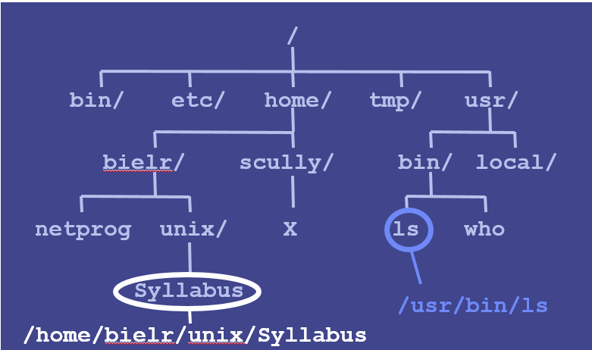
Relative Pathnames
Prefixed w/the current directory, $PWD
So, relative to the current working directory
$ cd /home/bielr
$ pwd
/home/bielr (current working dir)
$ ls unix/Syllabus (relative pathname)
unix/Syllabus
$ ls X
ls: X: No such file or directory (? )
$ ls /home/scully/X
/home/scully/X (found it!)

Slide 46
Special Relative paths…
. The current directory
.. The parent directory
$ pwd
/home/bielr
$ ls ./netprog
./netprog
$ ls ../scully
X

Slide 47
Some Standard Directories & Files 1 of 2
Root Directory ( / ). The top of the file system
/bin. The binary directory. Contains binary (executable) images of most UNIX/Linux commands.
/dev. The device directory. Has files corresponding to all the devices connected to the computer.
/etc. Contains commands and file for system administration. The typical user is usually not allowed to use these commands and files.

Slide 48
Some Standard Directories & Files 2 of 2
/lib. The library directory. Contains a collection of related files for a given language in a single file called archive. Many UNIX/Linux systems contain libraries for C, C++, and FORTRAN.
/tmp. Contains temporary files. The system admin determines the length of their life, usually only a few minutes.
/users. The home directory for all the users on a system.
/usr. UNIX System Resource. Contains subdirectories: utilities, tools, language libraries, manual pages.

Slide 49
Directories & Files

Slide 50
Location of many Startup and Customization files.
This type of file is most often located in a user’s home directory or off the root for a system file.
Some Examples:
/vimrc /bashrc /bash_profile /forward .plan
/mozilla/ /elm/ /logout

Slide 51
LINUX generic
directory structure
/
.profile, mbox, boot
users or home
bin
lib
dev
write
sort
whodo
cutdate
ldr
tty01
tty02
carson
david
joan
Each of these user then have their own files.

Slide 52
The root directory is always named “ / ”.
Parent directory is the one directly above another
directory.
Child directory is a directory directly below another
directory.
Sub-directory – another name for a child directory.

Slide 53
When you log on, you are put into your home directory.
Notice the full path name, starting with “/” for the root.
>pwd /* path of the working directory */
Result of a pwd in my own directory:
[bielr@ecs-pa-coding1 csc60]$ pwd
/home/college/bielr/csc60
Result of a pwd in a student directory:
[doejohn@ecs-pa-coding1] $ pwd
/home/student/doejohn

Slide 54
To return to your home directory:
> cd /* Change Directory */
To go to a sub-directory:
> cd directory-name
From my home directory, to get to the sub-directory:
> cd csc60
An alternate to cd is chdir.

Slide 55
Forming File Names:
All UNIX/Linux systems can handle file names of up to
14 characters. Some can use names as long as 256.
Names are formed from:
A to Z
a to z
0 to 9
_ (underscore)
. (period)
, (comma)
NO slash. Better not to use Space or Dash.

Slide 56
Creating a Directory:
mkdir
Example:
> mkdir csc60

Slide 57
Renaming Directories:
You must first be in the parent directory.
>mv original-name new-name
----------------------------------------------------
Removing Empty Directories:
>rmdir directory-name

Slide 58
Ambiguous File Names:
? Represents any other character
* Represents no character or any number of characters.
Examples:
*a All files with names ending in a
*[xyz] All files with names ending in x, y, or z.
*.? All files that contain a period with exactly one character
following.
?? All files with two-character names.
*.obj All files with .obj as the last four characters.
Be very careful using these symbols so you don’t delete everything.

Slide 59
3-X History, Files, Paths
END

